Slide 1
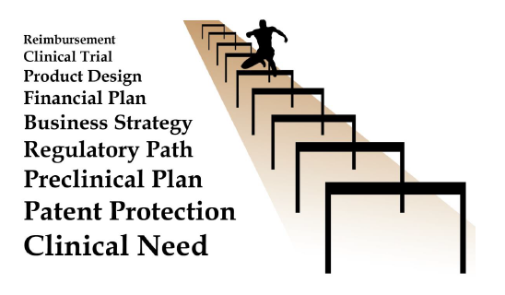
Translational Medicine Symposium:
Bench to Business to Bedside: Clearing the Hurdles to the Clinic
Presented by:
Amelia Smith Rinehart, Associate Professor of Law, University of Utah, S.J. Quinney College of Law
Dave Morrison, Marriott Library
Loren R. Hulse, Partner, Stoel Rives, LLP
February 11, 2014 • Salt Lake City, Utah

Slide 2

Intellectual Property Overview
Amelia Smith Rinehart, Associate Professor of Law, University of Utah, S.J. Quinney College of Law

Slide 3
An Overview of Intellectual Property
Patents
  Useful inventions protected for 20 years from filing
Copyrights
  Creative expressions protected for 70 (or 95 or 120) years plus the life of the author
Trademarks
  Marks used in commerce protected as long as in use
Trade Secrets
  Valuable secrets protected from theft by state law

Slide 4
Patents
Is your invention patent-eligible subject matter?
  “Anything under the sun made by man.”
  Myriad case eliminates patenting of all isolated DNA sequences (but maybe not cDNA).
  Mayo case eliminates patenting of some diagnostic methods.
  CLS Bank case to be decided this year on topic of software patenting.

Slide 5
Patents
Is your invention useful, novel and not obvious?
  Useful: more than a research plan or intermediary.
  Novelty: no single prior art reference discloses what you claim.
  Nonobvious: the difference between the collective prior art and your invention is not obvious to a skilled artisan in your field.

Slide 6
Patents
Identify all inventors.
Make an invention disclosure in accordance with the U Patent and Inventions Policy 7-002.
Conduct prior art search.
Consider planning for a reduction to practice. (Does the invention work for its intended purpose?)
Refrain from any public disclosure until, at least, invention evaluation by TVC and next steps formalized.

Slide 7
Patents
Build a strong disclosure.
  Timing and content are (often) everything.
  First-inventor-to-file system since March 2013.
Application must support your patent claims.
  Must enable a skilled artisan to make and use your invention, without undue experimentation.
  Must demonstrate that you were in possession of the invention.

Slide 8
Patents
File as early as you can.
But the scope of your disclosure dictates the scope of your exclusivity.
  Discussion of embodiments that retain, alter, or enhance function supports broader exclusivity.
  Conducting additional studies to obtain this data may delay your filing (and your priority date).

Slide 9
Patents
Seek counsel from the Technology & Venture Commercialization Office (TVC) and its IP Professionals.
They will:
  Search prior art, evaluate potential success.
  Recommend a commercialization plan for your technology, taking into account key programs and assets.
  Coordinate and pay for procurement by patent attorneys.

Slide 10
Patents
After you file an application…
  Expect to wait 1-3 years for issuance.
  Expect to be rejected, and to work with your patent professional to overcome rejections.
  Expect (and plan for) costs.
    Often the most expensive stage.
    Your involvement helps reduce costs
Your issued patent claims define your exclusive rights.

Slide 11
Patents
Ownership vests in the inventor(s).
Employees must assign employment-related inventions to University of Utah Research Foundation (UURF).
  TVC resources available.
  Obligation to keep TVC informed.
  Royalty-bearing.
Requires careful collaboration.

Slide 12
Trademarks
A trademark signals information to consumers about the source of a good or service.
  Federal, state, common law rights of varying scope.
  Protects brands, logos, trade dress, and much more.
  Cannot be generic or functional.
  Must be used in commerce on goods or services.

Slide 13
Copyrights
A copyright protects original, fixed works from reproduction, adaptation, distribution, public display, or public performance.
  Works include literary, dramatic, musical and artistic works such as poetry, novels, movies, songs, architecture, and computer software.
  Independent creation not liable for infringement.

Slide 14
Trade Secrets
Confidential information that can include a formula, compilation, program, device, method, technique, customer lists, or processes.
  The information must derive independent actual value from not being generally known or readily ascertainable by proper means.
  The secret holder must use reasonable efforts to maintain its secrecy.

Slide 15
Questions?
Amelia Smith Rinehart
Associate Professor of Law
University of Utah, S.J. Quinney College of Law
801-581-6034
amelia.rinehart@law.utah.edu

Slide 16
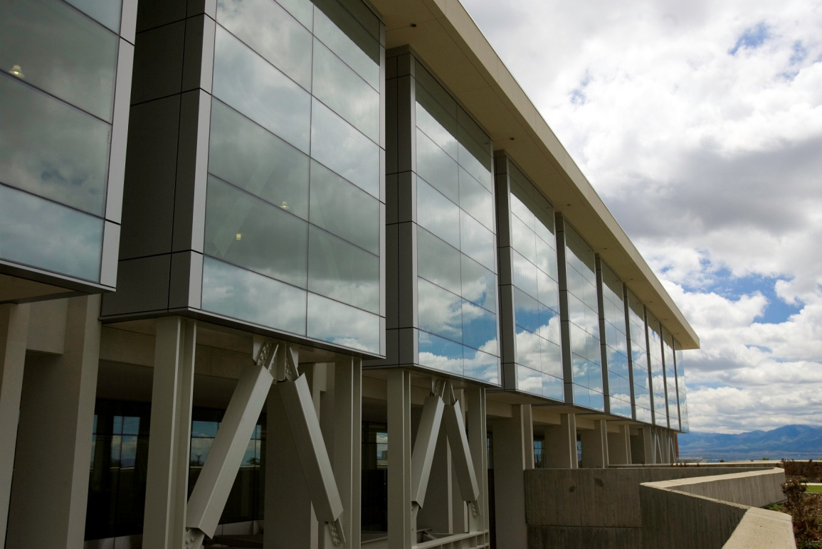

Patent Searching Basics
Dave Morrison, Marriott Library

Slide 17
Benefits of Searching
More confident in the novelty of your invention, which justifies your time, effort and money.
More aware of the ‘state of the art’
  What companies could be competitors, or future customers?
  How is the technology developing or changing; in which directions, and at what pace?

Slide 18
Benefits of Searching (Cont.)
Obtain glimpses of ‘new directions’ in which to take your own research.
  What are available ‘open spaces’ for innovation between existing patent ‘footprints?’
Become more familiar with technical and legal language, and be ‘a better informed consumer’ when talking with your own patent professionals!

Slide 19
Major Hurdles
Not all technology or prior art can be found on the Internet!
  Most information on the Internet is in the ‘Deep Web,’ and not available through free, public search engines like Google!
The most powerful commercial databases available are usually extremely expensive.
  Use the information resources that are freely-available at a major research library such as the Marriott Library of the University of Utah, and make sure to consult with subject specialists!

Slide 20
Major Hurdles (Cont.)
Keyword searching in patent databases will always be incomplete, unless augmented by classification searching!
  Patents use both technical and legal terminology – ‘jargon’ – which may be unfamiliar to the patent searcher.
  Keywords used for the patent search might not be consistently used in all relevant patents.
  The new Cooperative Patent Classification (CPC) system will replace the traditional US Patent Classification within a few years.

Slide 21
Guidelines for Successful Searching
Both the USPTO and Espacenet databases are good, free search tools with full-text patents available as PDFs.
  Espacenet also provides patent families
Google Patents may be particular helpful with ‘Prior Art’ searching
Start with keyword searching
  keywords, inventors’ names or company (‘assignee’) names
  When you find relevant patents, switch to searching by classification numbers so you don’t overlook relevant prior art.

Slide 22
Guidelines (Cont.)
When you locate patents relating to your own inventions, use the ‘prior art’ and ‘referenced by’ citations to locate earlier and later forms of your invention’s technology, or ‘art’
  In patents, these citations can be to other US patents; foreign patents; journal articles; legal documents; databases; manufacturer’s catalogs; etc.

Slide 23
Guidelines (Cont.)
Searching by keywords and phrases alone will not find everything you need to know about!
  The US and Cooperative Patent Classification Systems (USPC and CPC) group inventions together according to their technologies or how they work, despite differences in how they may be described.
When you’re ready to obtain a patent for a valuable technology, consider the value of an IP professional!

Slide 24
Selected USPTO Web Sites
USPTO Home Page
  [ www.uspto.gov ]
USPTO Patents Main Page
[ www.uspto.gov/main/patents.htm ]
USPTO Resources and Guidance
  [ http://uspto.gov/patents/resources/index.jsp ]
General Information Concerning Patents
  [http://www.uspto.gov/patents/resources/general_info_concerning_patents.jsp ]
  “The best introduction to patents and trademarks I’ve ever found! Originally about 87 pages in print, plus a handy list of FAQs.”

Slide 25
Selected USPTO Web Sites (Cont.)
Pro Se and Pro Bono
  “The page for those inventors either filing on their own behalf (pro se) or are seeking free or greatly reduced services from patent professionals.”
    [ http://www.uspto.gov/inventors/proseprobono/index.jsp ]
The Inventors Eye
  “The USPTO's bimonthly publication for the independent inventor community”
  [ http://www.uspto.gov/inventors/independent/eye/index.jsp ]
‘Basic Patent Training for the Independent Inventor and Small Businesses’ (USPTO video) [ https://uspto.connectsolutions.com/certificationpackage/ ]
Trademark Information Network (TMIN) Videos
  [ http://www.uspto.gov/trademarks/process/TMIN.jsp ]

Slide 26
Current Favorite Web Tools!
Esp@cenet (http://worldwide.espacenet.com)
    + Includes patents and applications from more than 80 countries!
    + Patents grouped into patent ‘families’ for a single invention;
    + Full patents and applications available for download as PDFs;
    - Searches using IPC and new CPC system, not USPC.
Google Patents (http://patents.google.com)
    + Fast!
    + Full patents and applications available as PDFs;
    + Searches for ‘Prior Art’ using Google search algorithm in the Google Scholar database and other Google products;
    + Searching through OCR for keywords goes back further than USPTO;
    - Not certain what specific patents or date ranges are unavailable.
freepatentsonline.com (www.freepatentsonline.com)
    + Export U.S. patents and applications into .xls files for easier sorting
    and analysis.

Slide 27
Questions?
Dave Morrison, Marriott Library
801-585-6802
dave.morrison@utah.edu

Slide 28
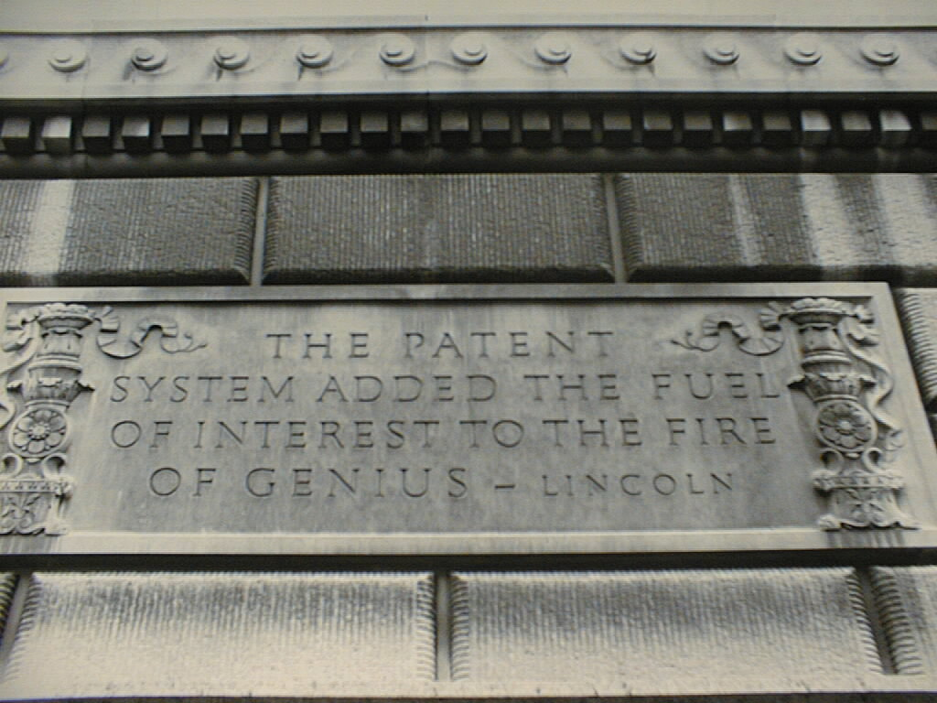
THANKS!

Slide 29

Developing Value through Intellectual Property
Loren R. Hulse
Partner, Stoel Rives LLP

Slide 30
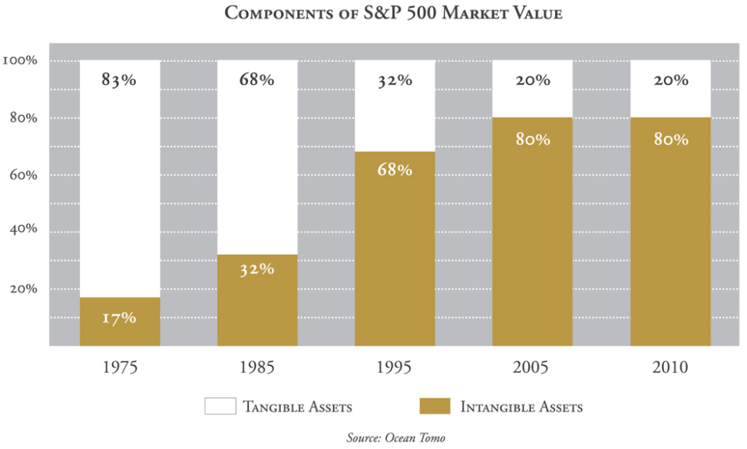
Intellectual Property

Slide 31
I.P. Strategy: Core Considerations:
Patent issues:
  When do I protect my technology?
  Do I own the rights I need?
Trademark issues:
  Is my trademark clear for use?
  Can I secure rights to it?
Seek counsel

Slide 32
Patent Issues : Timing
File first:
  Win the race to the patent office
    AIA: “First Inventor to File”
  Avoid loss of international rights
  Reduce risk of disputes
Monitor ongoing disclosures
Follow competitors’ patent applications

Slide 33
Patent Issues : Ownership
Assure clear title:
  Founders/owners should assign needed patents to the company
  Assure that I.P. developed by employees and contractors is owned by the company
    Employment agreements
Consider whether rights owned by others could be needed to assure freedom to operate.

Slide 34
Trademark Issues :
Check your trademark early:
  Avoid investment in a name that you may not be able to get rights to
  Reduce risk of conflicts with existing trademarks
  Move toward registration to expedite your move toward exclusivity in the trademark
Monitor your marks after registration

Slide 35
Seek Counsel
University technologies:
  Contact the Technology & Venture Commercialization Office
    Technology assessment, prior art searching and Intellectual property development
Independent technologies:
  Seek patent counsel that will keep your interests at the forefront and help you develop valuable exclusivity.

Slide 36
Questions?
Loren R. Hulse
lrhulse@stoel.com
801-578-6978
Thank you!

